Slide 1
Coding & Debugging workshop

Slide 2
Compilation
What is it?
Humanly readable code -> “Instructions”
How does it work?
csc.exe
What is created?
C# code
Intermediate Language (IL)
Native Code
C# compiler
JIT compiler
Code.cs
Code.exe
Code.dll
Code.pdb
21 0a 00 00
0a 11 56 02
Compile Time
RunTime

Slide 3
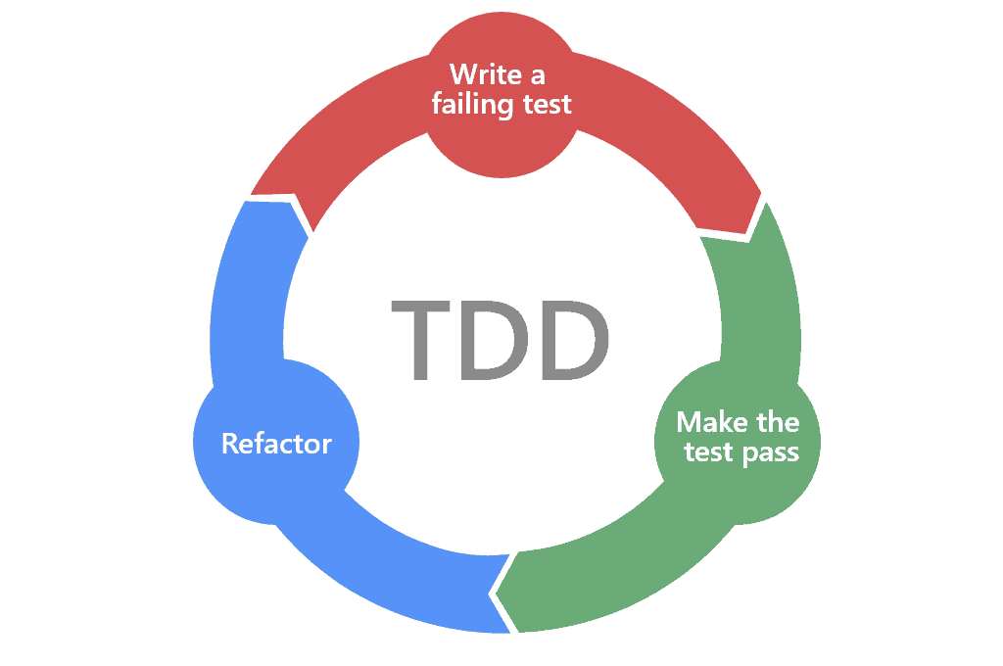
Testing
Fast review
Why?
Tests First
Test Driven Development
Fluent assertion
InternalsVisibleTo

Slide 4
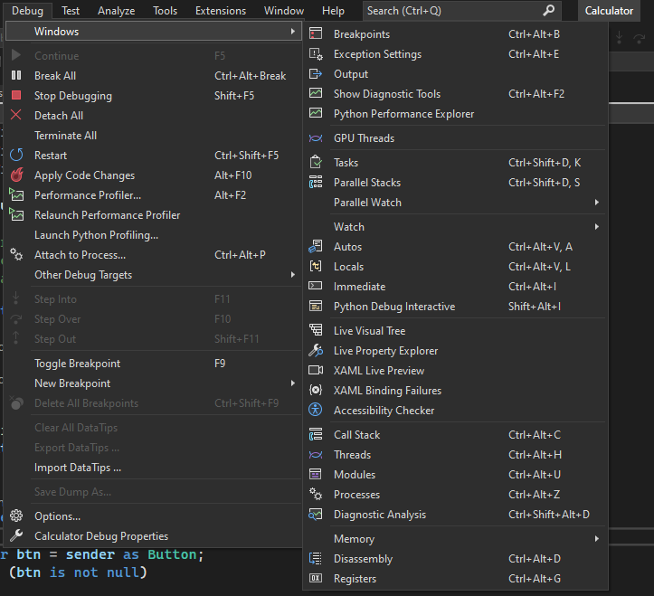
Debugging
Tips and Tricks
Debugger attaches to PID (attach to process)
Debug -> start a new instance
Debugger.Launch() – starting service or such
Windows: Threads, CallStack, Modules, Watch, …
Add new breakpoint
Remote Debugging – VS Remote Tools

Slide 5
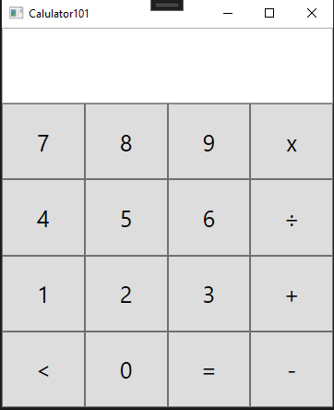
Calculator
Repo: https://github.com/HyperReap/TestableCalculator
WPF frontend
C# backend
xUnit tests

Slide 6
End of Introduction – Workshop Starts
Get repo: https://github.com/HyperReap/TestableCalculator
Let’s go through the code
Try to compile it and run it
Some Tips and Tricks
Debug
Remote Debugging?

Slide 7
TODO List:
Get repo: https://github.com/HyperReap/TestableCalculator
TaskList in VS – View -> TaskList
CallStack in VS – Debug -> Windows -> Call Stack
//TODO:: (1) add more tests for different operations
//TODO:: (2) implement - / * operations, use TDD
//TODO:: (3) use methods from MathBase
//TODO:: (4) implement checkInputSyntax
//TODO:: (5) Add operation for factorial
//TODO:: (6) Check out and debug functions for calculating factorial
//TODO:: (6) Check out Callstack while debugging

